Slide 1
Data Structures Algorithm and Design SSZG519
Mr. Chennupati R Prasanna

Slide 2
SSZG519-Introduction to Algorithms

Slide 3
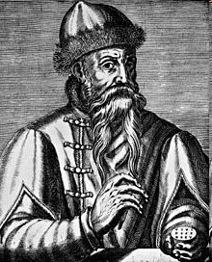
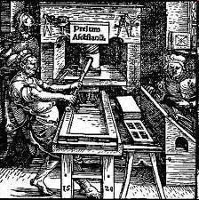
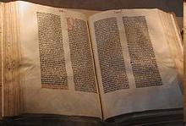
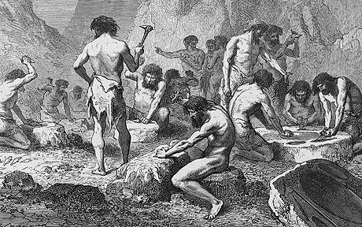
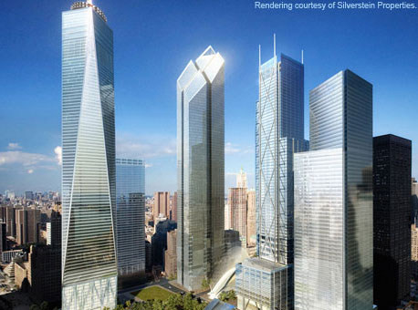
Two discoveries that changed the world !!
Johannes Gutenberg (1398 - February 3, 1468)

Slide 4
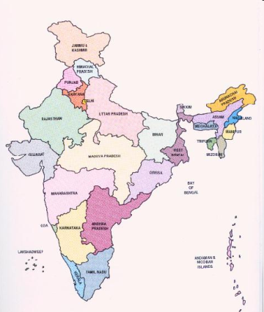
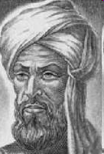
Two discoveries that changed the world !!
Decimal System invented in India around 600AD
Al Khwarizmi (780 AD – 850 AD) from Baghdad laid out basic methods for adding, subtracting, multiplication and dividing numbers
These procedures were precise, unambiguous, mechanical, efficient, correct
In short they were called Algorithms (a term coined to honor Al Khwarizmi - algorithm stem from Algoritmi, the Latin form of his name)

Slide 5
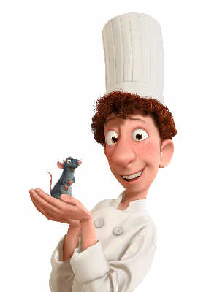

What is an algorithm?
A clearly specified set of simple instructions to be followed to solve a problem
Takes a set of values, as input and
produces a value, or set of values, as output
May be specified
In English or Hindi or Telugu
As a computer program
As a pseudo-code
Input
Algorithm
Output

Slide 6

Some Vocabulary with an example
Problem: Sorting of given keys
Input: A sequence of n keys a1, . . . , an.
Output: The permutation (reordering) of the input sequence such that a1 ≤ a2 ≤ · · · ≤ an−1 ≤ an.
Instance: An instance of sorting might be an array of names, like {Mike, Bob, Sally, Jill ,Jan}, or a list of numbers like {154, 245, 568, 324, 654, 324}
Algorithm: An algorithm is a procedure that takes any of the possible input instances and transforms it to the desired output.

Slide 7


Which algorithm is better?
Who is topper in DSDA?
Algorithm 1:
Sort A into decreasing order
Output A[1].
Algorithm 2:
int i;
int m = A[1];
for (i = 2; i <= n; i ++)
if (A[i] > m)
m = A[i];
return m;
Which is better?

Slide 8


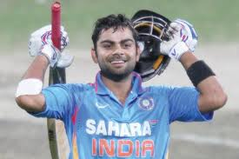
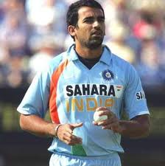
Who’s the champion?

Slide 9
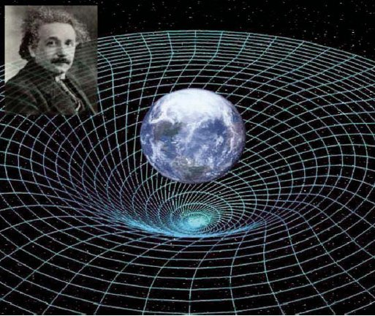
“Better” = more efficient
Time
Space
Measure efficiency (asymptotic notation)
O(n)
o(n)
Ω(n)
Ө(n)

Slide 10
Sorting Algorithms
Comparison Based
Bubble Sort
Quick Sort
Insertion Sort
Merge Sort
Heap Sort
3
7
9
17
5
2
21
18
33
4
17
9
7
5
3
33
21
18
4
2
Non-Comp Based
Radix Sort
Bucket Sort
?
Randomized
Quick Sort
33
21
18
17
9
7
5
4
3
2
Lower bound on comparison based algorithms

Slide 11
Data Structures
Name of array (Note that all elements of this array have the same name, c)
c[0]
-45
Array
c[1]
6
Linearly Ordered Set
c[2]
0
c[3]
72
c[4]
1543
c[5]
-89
c[6]
0
Head
Linked List
c[7]
62
node
node
c[8]
-3
Data
Next
Data
Next
c[9]
1
c[10]
6453
c[11]
78
object2
object
Position number of the element within array c

Slide 12
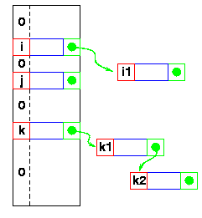
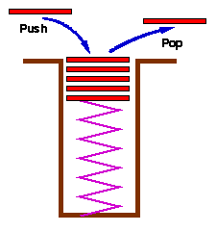
Data Structures
Hash Tables
Stack
Set with delete operation specified (LIFO)
Queue
Remove (Dequeue)
Insert (Enqueue)
front
rear

Slide 13
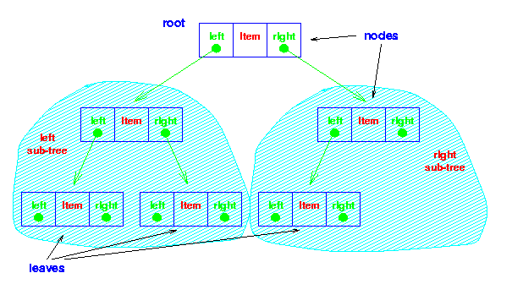
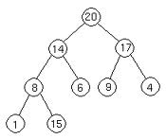

Data Structures
Binary Tree
Heap
26
17
41
Red Black Tree
14
21
30
47
10
16
19
23
28
38
7
12
15
20
35
39
3

Slide 14
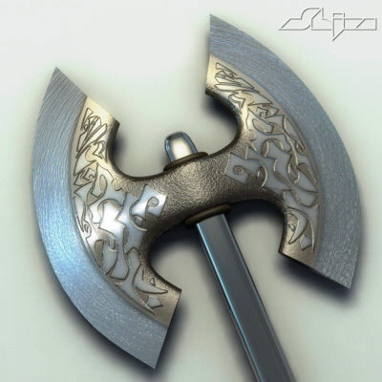
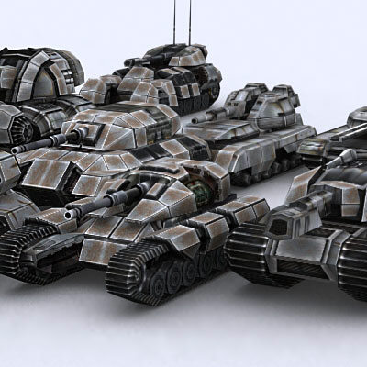


Algorithm Techniques – Divide and Conquer
Matrix Multiplication
Nearest Points

Slide 15
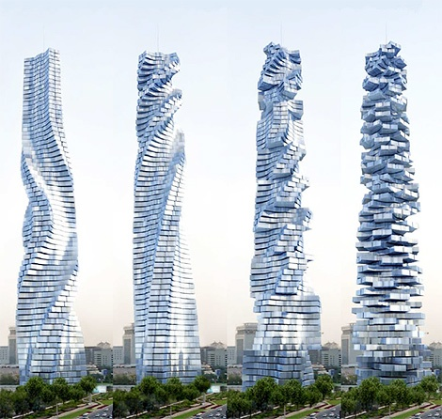
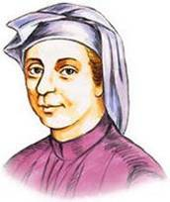
Algorithm Techniques – Dynamic Programming
Efficient algorithm
to compute F(n)
Leonardo Fibonacci
1170-1250

Slide 16
Algorithm Techniques – Dynamic Programming
Matrix Chain Product

Slide 17
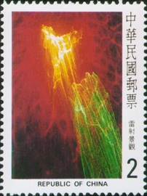
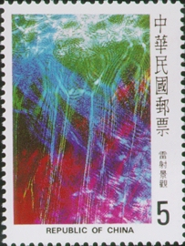
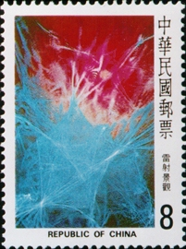
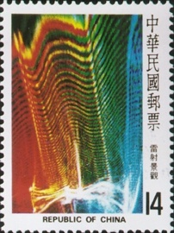
Algorithm Techniques – Dynamic Programming
If the postage is n, what is the minimum number of stamps to cover the postage?

Slide 18
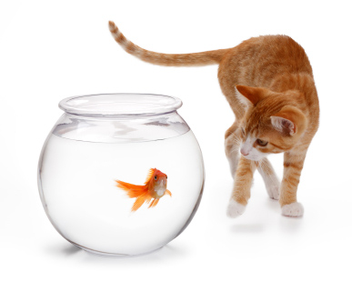
Algorithm Techniques – Greedy Approach
Krusal’s Minimum Spanning Tree Algorithms
8
10
14
10
14
1
3
5
7
1
3
5
7
7
3
7
4
6
3
2
4
12
6
2
2
4
6
8
2
4
6
8
9
Prim’s Minimum Spanning Tree Algorithms
8
10
14
10
14
1
3
5
7
1
3
5
7
7
3
7
4
6
3
2
4
12
6
2
2
4
6
8
2
4
6
8
9

Slide 19
Algorithm Techniques – Greedy Approach
Task Selection Problem: Selecting as many disjoint tasks as possible.

Slide 20
Graph Algorithms
u
3
2
2
Shortest Path Algorithms:
Dijkstra’s,
Floyd-Warshall’s
All Pairs Shortest Path Algoirthm
1
1
3
-3
1
v
2
MST Algorithms:
Borůvka,
Kruskal & Prim (emphasis on Greedy approach )
Graph Search Methods:
BFS
DFS

Slide 21
P, NP, NP-Complete, NP Hard
Complexity Class P
Set of all decision problems (or languages) that can be solved in polynomial time
Complexity Class NP
Set of all decision problems (or languages) that can be verified by a polynomial-time algorithm
NP-completeness
A language L is NP-complete if
L is in NP and
All other languages in NP are polynomially reducible to L
NP-hard
A language L is NP-hard if
All other languages in NP are polynomially reducible to L
NPC
NP
P

Slide 22
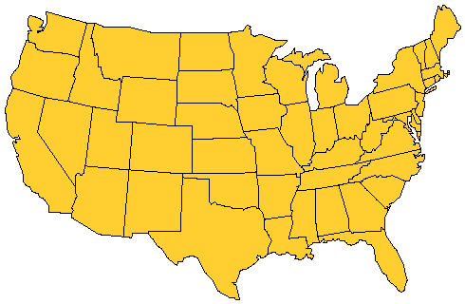
P, NP, NP-Complete, NP Hard
Home city
Visit city
Notes:
Once a month the salesperson starts from home and visits each city in his/her territory once. When done, the salesperson returns home. The salesperson wishes to minimize time spent in this activity. Assuming that the time spent at each city is fixed, total time is minimized by minimizing travel time. So, a tour of minimum length is desired.

Slide 23
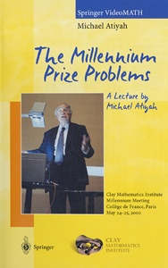
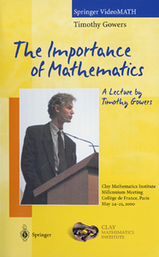
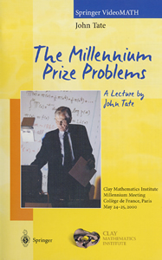
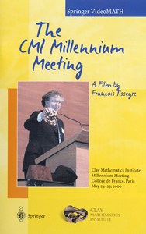
Millennium problems (US $1,000,000 per problem)
Birch and Swinnerton-Dyer Conjecture
Hodge Conjecture
Navier-Stokes Equations
Is P = NP?
Poincaré Conjecture
Riemann Hypothesis
Yang-Mills Theory

Slide 24
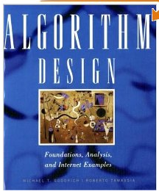
Text Book
Micheal T. Goodrich and Roberto Tamassia: Algorithm Design: Foundations, Analysis and Internet examples (John Wiley &Sons, Inc., 2002)

Slide 25
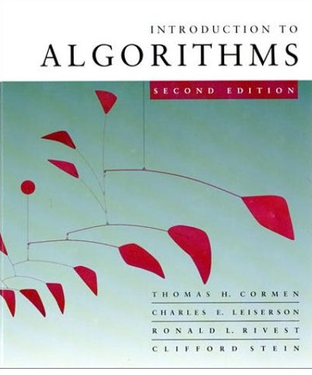



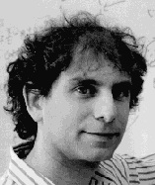
Reference Books
Also known as CLRS book

Slide 26
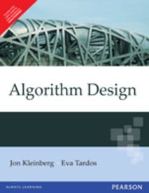
Reference Books
Jon Kleinberg and Eva Tardos. Algorithm Design. Pearson Education. (2007)

Slide 27
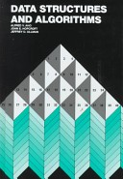
Reference Books
Data Structures and Algorithms - Alfred V. Aho, John E. Hopcroft, Jeffery D.Ulman

Slide 28
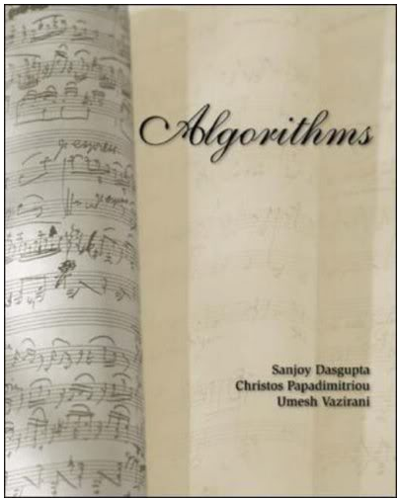

Reference Books
Sanjoy Das Gupta, Christos Papadimitriou, Umesh Vazirani: Algorithms
(Tata McGraw-Hill Publishers)

Slide 29
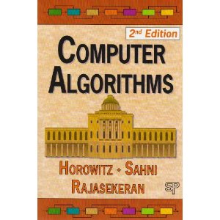
Reference Books
Ellis Horowitz, Sartaj Sahni, Sanguthevar Rajasekaran. Computer Algorithms

Slide 30
Thank You!!

